Slide 1
Bootstrap 4
18-Mar-18 | Start
Appendix
Online

Slide 2
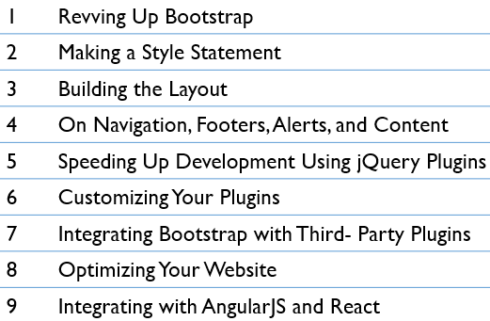
Bootstrap 4
Ch | Date
1 | 27-Mar-18
2
3
4
5
6
7
8
Mastering Bootstrap 4 10 2016

Slide 3
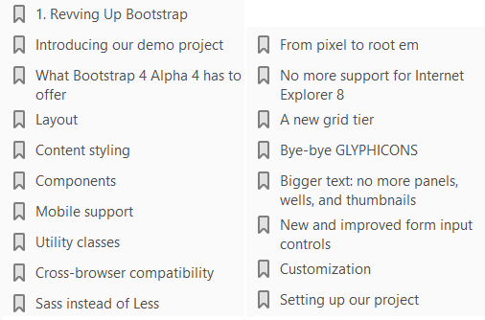
1
Revving Up Bootstrap

Slide 4
Intro
Bootstrap is a web development framework that helps developers build web interfaces.
Originally conceived at Twitter in 2011 by Mark Otto and Jacob Thornton, the framework is now open source and has grown to be one of the most popular web development frameworks to date.
Being freely available for private, educational, and commercial use meant that Bootstrap quickly grew in popularity. Today, thousands of organizations rely on Bootstrap, including NASA, Walmart, and Bloomberg.
According to BuiltWith.com , over 10% of the world's top 1 million websites are built using Bootstrap.
The framework itself consists of a mixture of JavaScript and CSS, and provides developers with all the essential components required to develop a fully functioning web user interface.

Slide 5
Introducing to demo project
The concept behind our website is simple: to develop a landing page for photographers.
Using this landing page, (hypothetical) users will be able to exhibit their wares and services.
While building our website, we will be making use of the same third-party tools and libraries that you would if you were working as a professional software developer.
The tools that we will use to assist us throughout the development of MyPhoto are
Bower
Node Package Manager (npm) and
Grunt.
From a development perspective, the construction of MyPhoto will teach you how to use and apply all of the essential user interface concepts and components required to build a fully functioning website.

Slide 6
Demo Project: Agenda
You will learn how to do the following:
Use the Bootstrap grid system to structure the information presented on your website
Create a fixed, branded, navigation bar with animated scroll effects
Use an image carousel for displaying different photographs, implemented using Bootstrap's carousel.js and jumbotron.
Build custom tabs that allow users to navigate across different contents
Use and apply Bootstrap's modal dialogs
Apply a fixed page footer
Create forms for data entry using Bootstrap's input controls (text fields, text areas, and buttons) and apply Bootstrap's input validation styles
Make best use of Bootstrap's context classes
Create alert messages and learn how to customize them

Slide 7
Demo Project: Agenda |
Rapidly develop interactive data tables for displaying product information
Use drop-down menus, custom fonts, and icons

Slide 8
Third-party Libraries
The development of MyPhoto will introduce you to a range of third-party libraries such as
Scrollspy (for scroll animations)
SalvattoreJS (a library for complementing our Bootstrap grid)
Animate.css (for beautiful CSS animations, such as fade-in effects)
Bootstrap DataTables (for rapidly displaying data in tabular form)

Slide 9
Website Sections
The website itself will consist of different sections:
A Welcome section An About section
A Services section A Gallery section
A Contact Us section
By developing the Welcome section, you will learn how to use Bootstrap's jumbotron and alert dialogs along with different font and text styles
The About section will show you how to use cards.
The Services section of our project introduces you to Bootstrap's custom tabs.
Further, you will use rich imagery to really show off the website's sample services. You will achieve this by really mastering Bootstrap's responsive core along with Bootstrap's carousel and third-party jQuery plugins.
Last but not least, the Contact Us section will demonstrate how to use Bootstrap's form elements and helper functions.
Take a look at the Figure 1.1.

Slide 10
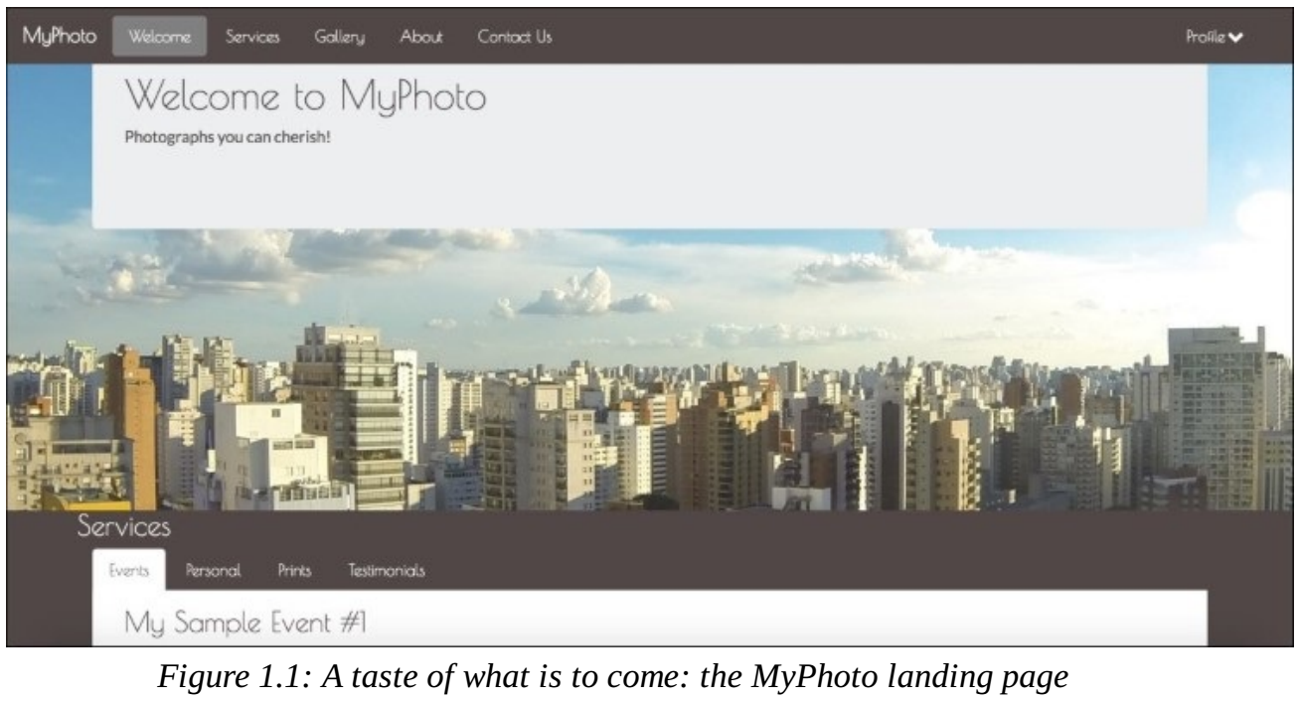
Figure 1.1

Slide 11
What Bootstrap 4 Alpha 4 has to offer
Much has changed since Twitter's Bootstrap was first released on August 19th, 2011.
Bootstrap 1 was a collection of CSS rules offering developers the ability to lay out their website, create forms, buttons, and help with general appearance and site navigation.
With respect to these core features, Bootstrap 4 Alpha 4 is still much the same as its predecessors.
In other words, the framework's focus is still on allowing developers to create layouts, and helping to develop a consistent appearance by providing stylings for buttons, forms, and other user interface elements.
How it helps developers achieve and use these features, however, has changed entirely.
Bootstrap 4 is a complete rewrite of the entire project, and, as such, ships with many fundamental differences to its predecessors.
Along with Bootstrap's major features, we will be discussing the most striking differences between Bootstrap 3 and Bootstrap 4 in the sub-sections that follow.

Slide 12
Layout
Possibly the most important and widely used feature is Bootstrap's ability to lay out and organize your page. Specifically, Bootstrap offers the following:
Responsive containers
Responsive breakpoints for adjusting page layout in response to differing screen sizes
A 12 column grid layout for flexibly arranging various elements on your page
Media objects that act as building blocks and allow you to build your own structural components
Utility classes that allow you to manipulate elements in a responsive manner.
For example, you can use the layout utility classes to hide elements, depending on screen size

Slide 13
Content Styling
Just like its predecessor, Bootstrap 4 overrides the default browser styles.
This means that many elements, such as lists or headings, are padded and spaced differently.
The majority of overridden styles only affect spacing and positioning; however, some elements may also have their border removed.
The reason behind this is simple: to provide users with a clean slate upon which they can build their site.
Building on this clean slate, Bootstrap 4 provides styles for almost every aspect of your web page such as buttons (Figure 1.2), input fields, headings, paragraphs, special inline texts, such as keyboard input (Figure 1.3), figures, tables, and navigation controls.
Aside from this, Bootstrap offers state styles for all input controls, for example, styles for disabled buttons or toggled buttons.

Slide 14
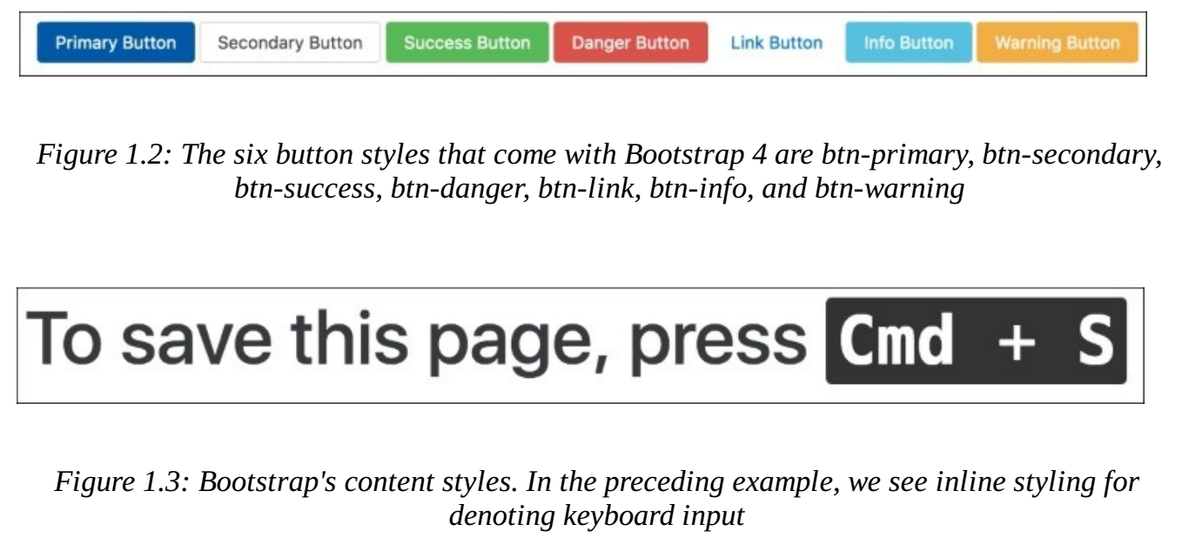
Figure 1.2 || 1.3

Slide 15
Components
Aside from layout and content styling, Bootstrap offers a large variety of reusable components that allow you to quickly construct your website's most fundamental features.
Bootstrap's UI components encompass all of the fundamental building blocks that you would expect a web development toolkit to offer:
modal dialogs progress bars navigation bars tooltips popovers
a carousel alerts drop-down menus input groups tabs
pagination components for emphasizing certain contents.
Let's have a look at the following modal dialog (Figure 1.4)

Slide 16
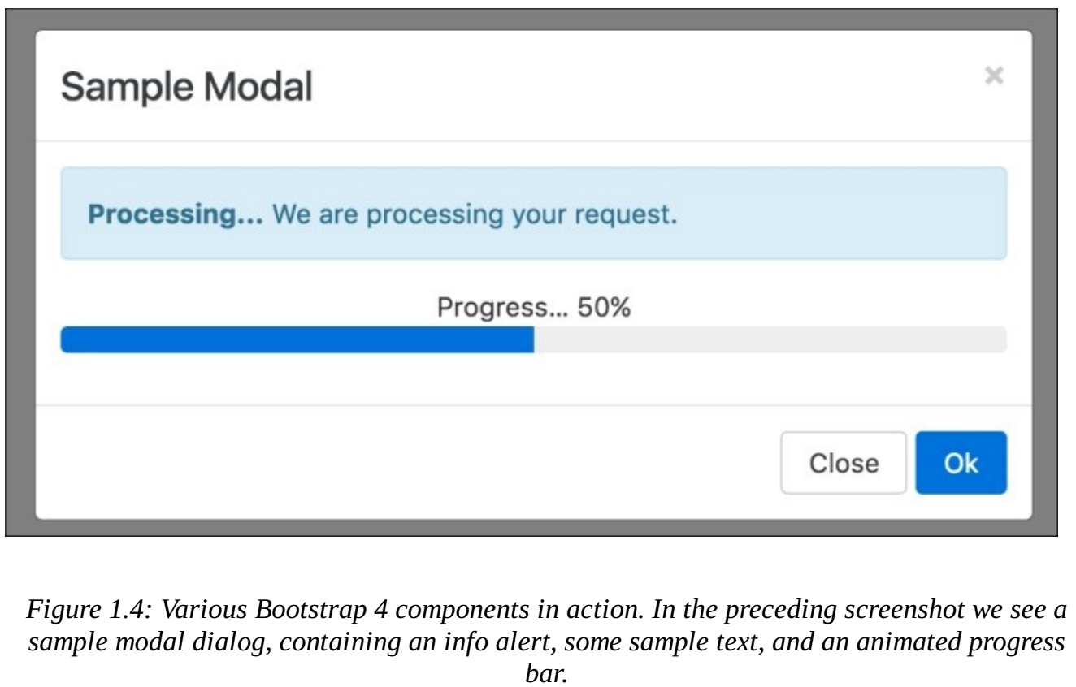
Figure 1.4

Slide 17
Mobile support
Similar to its predecessor, Bootstrap 4 allows you to create mobile-friendly websites without too much additional development work.
By default, Bootstrap is designed to work across all resolutions and screen sizes, from mobile, to tablet, to desktop.
In fact, Bootstrap's mobile-first design philosophy implies that its components must display and function correctly at the smallest screen size possible.
The reasoning behind this is simple. Think about developing a website without consideration for small mobile screens. In this case, you are likely to pack your website full of buttons, labels, and tables.
You will probably only discover any usability issues when a user attempts to visit your website using a mobile device only to find a small web page that is crowded with buttons and forms.
At this stage, you will be required to rework the entire user interface to allow it to render on smaller screens.
For precisely this reason, Bootstrap promotes a bottom-up approach, forcing developers to get the user interface to render correctly on the smallest possible screen size, before expanding upwards.

Slide 18
Utility classes
Aside from ready-to-go components, Bootstrap offers a large selection of utility classes that encapsulate the most commonly needed style rules.
For example
rules for aligning text
hiding an element, or
providing contextual colors for warning text

Slide 19
Cross-browser compatibility
Bootstrap 4 supports the vast majority of modern browsers, including
Chrome
Firefox
Opera
Safari
Internet Explorer (version 9 and onwards; Internet Explorer 8 and below are not supported), and
Microsoft Edge

Slide 20
Sass instead of Less
Both Less and Sass (Syntactically Awesome Stylesheets) are CSS extension languages.
These are languages that extend the CSS vocabulary with the objective of making the development of many, large, and complex style sheets easier.
Although Less and Sass are fundamentally different languages, the general manner in which they extend CSS is the same, both rely on a preprocessor.
As you produce your build, the preprocessor is run, parsing the Less/Sass script and turning your Less or Sass instructions into plain CSS.
Less is the official Bootstrap 3 build, while Bootstrap 4 has been developed from scratch, and is written entirely in Sass.
Both Less and Sass are compiled into CSS to produce a single file, bootstrap.css. It is this CSS file that we will be primarily referencing throughout this book (with the exception of Chapter 3 , Building the Layout).

Slide 21
From pixel to root em
Unlike its predecessor, Bootstrap 4 no longer uses pixel (px) as its unit of typographic measurement.
Instead, it primarily uses root em (rem).
The reasoning behind choosing rem is based on a well known problem with px; websites using px may render incorrectly, or not as originally intended, as users change the size of the browser's base font.
Using a unit of measurement that is relative to the page's root element helps address this problem, as the root element will be scaled relative to the browser's base font.
In turn, a page will be scaled relative to this root element.

Slide 22
Typographic units of measurement
Typographic units of measurement determine the size of your font and elements.
The most commonly used units of measurement are px and em.
The former is an abbreviation for pixel, and uses a reference pixel to determine a font's exact size.
This means that, for displays of 96 dots per inch (dpi), 1 px will equal an actual pixel on the screen.
For higher resolution displays, the reference pixel will result in the px being scaled to match the display's resolution.
For example, specifying a font size of 100 px will mean that the font is exactly 100 pixels in size (on a display with 96 dpi), irrespective of any other element on the page.
Em is a unit of measurement that is relative to the parent of the element to which it is applied.
Example, if we were to have two nested div elements, the outer element with a font size of 100 px and the inner element with a font size of 2 em, then the inner element's font size would translate to 200 px (as in this case 1 em = 100 px).
The problem with using a unit of measurement that is relative to parent elements is that it increases your code's complexity, as the nesting of elements makes size calculations more difficult.
The recently introduced rem measurement aims to address both em's and px's shortcomings by combining their two strengths; instead of being relative to a parent element, rem is relative to the page's root element.

Slide 23
No more support for Internet Explorer 8
The latest version of Bootstrap no longer supports Internet Explorer 8.
As such, the decision to only support newer versions of Internet Explorer was a reasonable one, as not even Microsoft itself provides technical support and updates for Internet Explorer 8 anymore (as of January 2016).
Furthermore, Internet Explorer 8 does not support rem, meaning that Bootstrap 4 would have been required to provide a workaround.
This in turn would most likely have implied a large amount of additional development work, with the potential for inconsistencies. Lastly, responsive website development for Internet Explorer 8 is difficult, as the browser does not support CSS media queries.
Given these three factors, dropping support for this version of Internet Explorer was the most sensible path of action.

Slide 24
A new grid tier
Bootstrap's grid system consists of a series of CSS classes and media queries that help you lay out your page.
Specifically, the grid system helps alleviate the pain points associated with horizontal and vertical positioning of a page's contents and the structure of the page across multiple displays.
With Bootstrap 4, the grid system has been completely overhauled, and a new grid tier has been added with a breakpoint of 480 px and below.

Slide 25
Bye-bye GLYPHICONS
Bootstrap 3 shipped with a nice collection of over 250 font icons, free of use.
In an effort to make the framework more lightweight (and because font icons are considered bad practice), the GLYPHICON set is no longer available in Bootstrap 4.

Slide 26
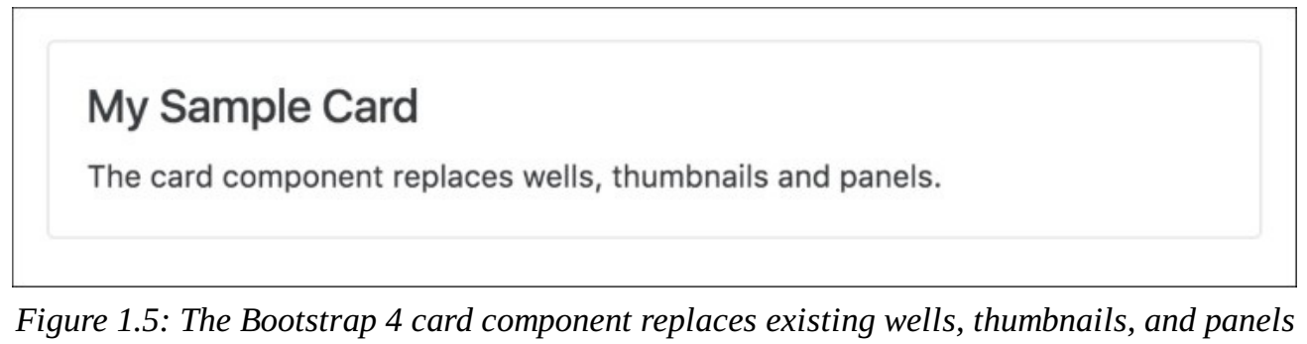
Bigger text: no more panels, wells, and thumbnails
The default font size in Bootstrap 4 is 2 px bigger than in its predecessor, increasing from 14 px to 16 px.
Furthermore, Bootstrap 4 replaced panels, wells, and thumbnails with a new concept: cards.
A well is a UI component that allows developers to highlight text content by applying an inset shadow effect to the element to which it is applied.
A panel also serves to highlight information, but by applying padding and rounded borders.
Cards serve the same purpose as their predecessors, but are less restrictive as they are flexible enough to support different types of content, such as images, lists, or text.
They can also be customized to use footers and headers. Take a look at the following screenshot:

Slide 27
New and improved form input controls
Bootstrap 4 introduces new form input controls: a color chooser, a date picker, and a time picker.
In addition, new classes have been introduced, improving the existing form input controls.
For example, Bootstrap 4 now allows for input control sizing, as well as classes for denoting block and inline level input controls.
However, one of the most anticipated new additions is Bootstrap's input validation styles, which used to require third-party libraries or a manual implementation, but are now shipped with Bootstrap 4 (see Figure 1.6).
Last but not least, Bootstrap 4 also offers custom forms in order to provide even more cross-browser UI consistency across input elements (Figure 1.7).
As noted in the Bootstrap 4 Alpha 4 documentation, the input controls are "built on top of semantic and accessible markup, so they're solid replacements for any default form control“.

Slide 28
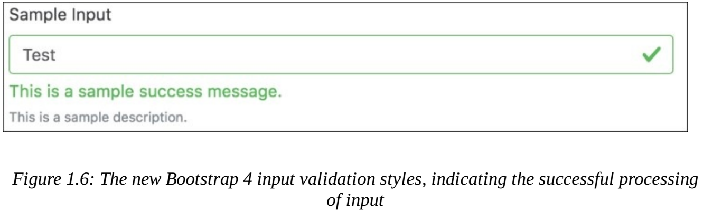
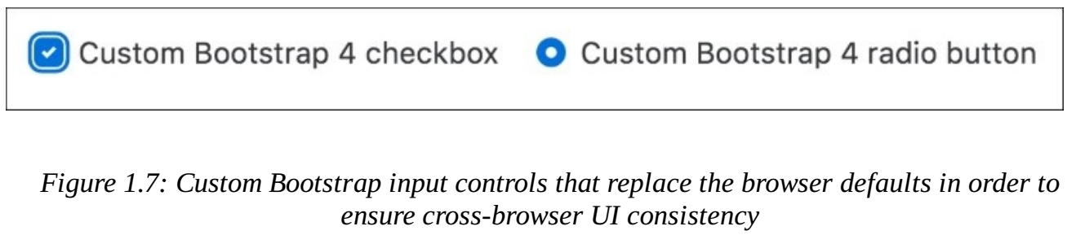
Figure 1.6 || 1.7

Slide 29
Customization
The developers behind Bootstrap 4 have put specific emphasis on customization throughout the development of Bootstrap 4.
As such, many new variables have been introduced that allow for the easy customization of Bootstrap.
Using the $enabled-*- Sass variables, one can now enable or disable specific global CSS preferences.

Slide 30
Setting up our project
Follow the below steps to set up the project:
Create a new project directory named MyPhoto. This will become our project root directory.
Create a blank index.html file and insert the following HTML code (Code 1.1):
Note the three meta tags.
The first tag tells the browser that the document in question is utf-8 encoded.
Since Bootstrap optimizes its content for mobile devices, the subsequent meta tag is required to help with viewport scaling.
The last meta tag forces the document to be rendered using the latest document rendering mode available if viewed in Internet Explorer.
Open the index.html in your browser.
You should see just a blank page with the words
Hello World

Slide 31
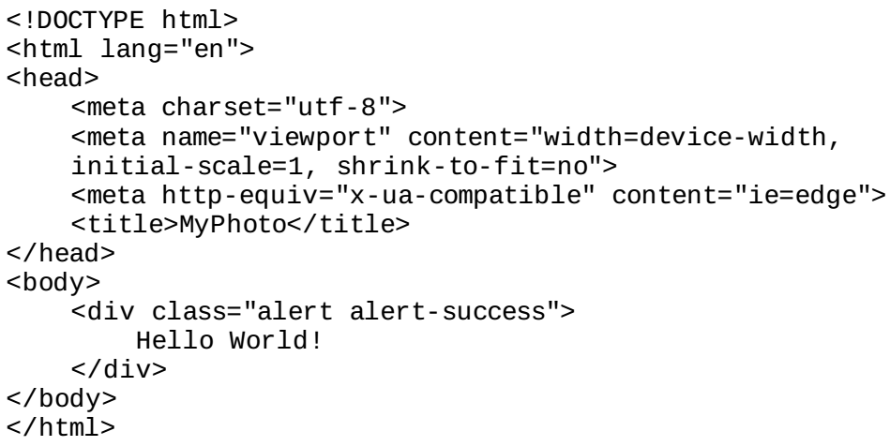
Code 1.1

Slide 32
Viewport scaling
The term "viewport" refers to the available display size to render the contents of a page.
The viewport meta tag allows you to define this available size.
Viewport scaling using meta tags was first introduced by Apple and, at the time of writing, is supported by all major browsers.
Using the width parameter, we can define the exact width of the user's viewport.
For example, <meta name="viewport" content="width=320px"> will instruct the browser to set the viewport's width to 320px.
The ability to control the viewport's width is useful when developing mobile-friendly websites; by default, mobile browsers will attempt to fit the entire page onto their viewports by zooming out as far as possible.
This allows users to view and interact with websites that have not been designed to be viewed on mobile devices.

Slide 33
Viewport scaling |
However, as Bootstrap embraces a mobile-first design philosophy, a zoom out will, in fact, result in undesired side-effects.
For example, breakpoints will no longer work as intended, as they now deal with the zoomed-out equivalent of the page in question.
This is why explicitly setting the viewport width is so important.
By writing content="width=device-width, initial-scale=1, shrink-to-fit=no", we are telling the browser the following:
We want to set the viewport's width equal to the actual device's screen width.
We do not want any zoom, initially.
We do not wish to shrink the content to fit the viewport.

Slide 34
Including Bootstrap: CDN
At its core, Bootstrap is a glorified CSS style sheet.
Within that style sheet, Bootstrap exposes very powerful features of CSS with an easy-to-use syntax.
It being a style sheet, you include it in your project as you would with any other style sheet that you might develop yourself.
That is, open the index.html and directly link it to the style sheet.
CDN: For now, we will use the Bootstrap builds hosted on Bootstrap's official Content Delivery Network (CDN).
This is done by including the following HTML tag into the head of your HTML document:
Bootstrap relies on jQuery, a JavaScript framework that provides a layer of abstraction in an effort to simplify the most common JavaScript operations (such as element selection and event handling).

Slide 35
Including Bootstrap: CDN |
Therefore, before we include the Bootstrap JavaScript file, we must first include jQuery.

Slide 36
What is a Content Delivery Network?
The objective behind any Content Delivery Network (CDN) is to provide users with content that is highly available.
This means that a CDN aims to provide you with content, without this content ever (or rarely) becoming unavailable.
To this end, the content is often hosted using a large, distributed set of servers.
The BootstrapCDN basically allows you to link to the Bootstrap style sheet so that you do not have to host it yourself.
Save your changes and reload the index.html in your browser. The Hello World string should now contain a green background:

Slide 37
Tether: Third-party Library
Tether is a JavaScript library for efficiently making an absolutely positioned element stay next to another element on the page.
For example, you might want a tooltip or dialog to open, and remain, next to the relevant item on the page.
Tether includes the ability to constrain the element within the viewport, its scroll parent, any other element on the page, or a fixed bounding box.
When it exceeds those constraints it can be pinned to the edge, flip to the other side of its target, or hide itself.
Tether is available via the CloudFare CDN, and consists of both a CSS file and a JavaScript.
As before, we should include the JavaScript file at the bottom of our document while we reference Tether's style sheet from inside our document head (Code 1.2):

Slide 38
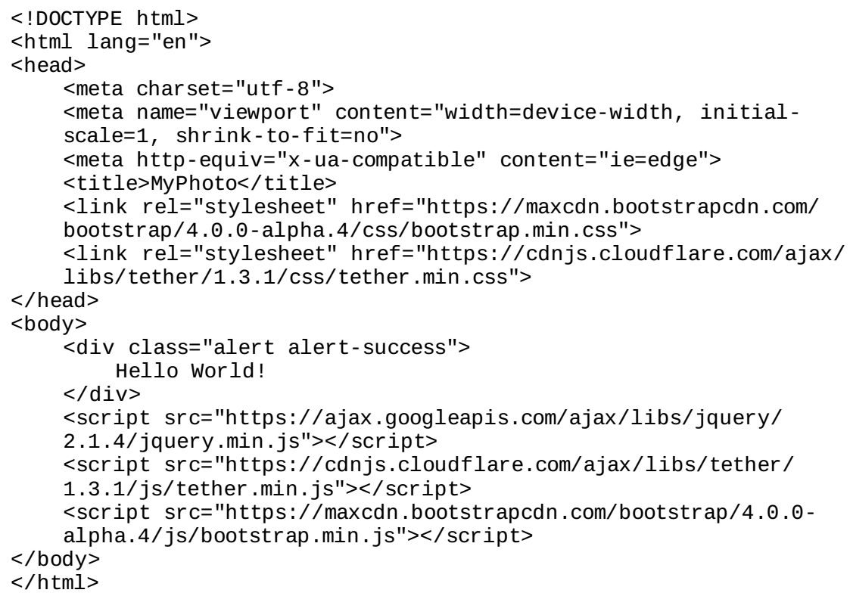
Code 1.2

Slide 39

How do I install Bower?
Before you can install Bower, you will need two other tools:
Node.js
Git
The latter is a version control tool, in essence; it allows you to manage different versions of your software.
To install Git, head over to http://git-scm.com/ and select the installer appropriate for your operating system.
NodeJS is a JavaScript runtime environment needed for Bower to run.
To install it, simply download the installer from the official NodeJS website: https://nodejs.org/
Once you have successfully installed Git and NodeJS, you are ready to install Bower. Simply type the following command into your terminal:

Slide 40
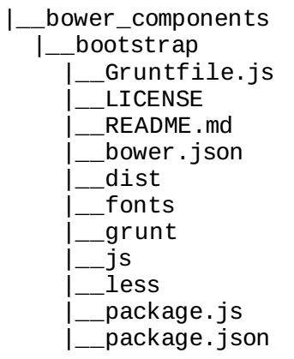
Installing Bootstrap
Open up your terminal, navigate to the project root folder you created earlier, and fetch the bootstrap build:
This will create a new folder structure in our project root:
Go ahead and open the dist directory. You should see three sub directories:
css
fonts
js

Slide 41
Installing Bootstrap |
The name dist stands for distribution. Typically, the distribution directory contains the production-ready code that users can deploy.
As its name implies, the css directory inside dist includes the ready-for-use style sheets.
Likewise, the js directory contains the JavaScript files that compose Bootstrap.
Lastly, the fonts directory holds the font assets that come with Bootstrap.
To reference the local Bootstrap CSS file in our index.html, modify the href attribute of the link tag that points to the bootstrap.min.css:
Let's do the same for the Bootstrap JavaScript file:

Slide 42

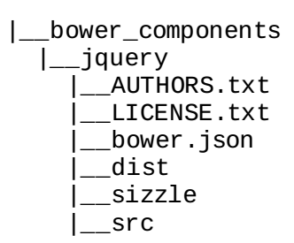
Installing jQuery
To install jQuery using Bower, use the following command:
This will create a new folder structure in our project root:
Reference jquery.min.js file by modifying the src attribute of the script tag that currently points to Google's jquery.min.js by replacing the URL with the path to our local copy of jQuery:

Slide 43

Installing Tether
To install Tether using Bower, use the following command:
Once the installation completes, a similar folder structure than the ones for Bootstrap and jQuery will have been created.
Verify the contents of bower_components/tether/dist and replace the CDN Tether references in our document with their local equivalent.
Refresh the index.html in your browser to make sure that everything works.

Slide 44
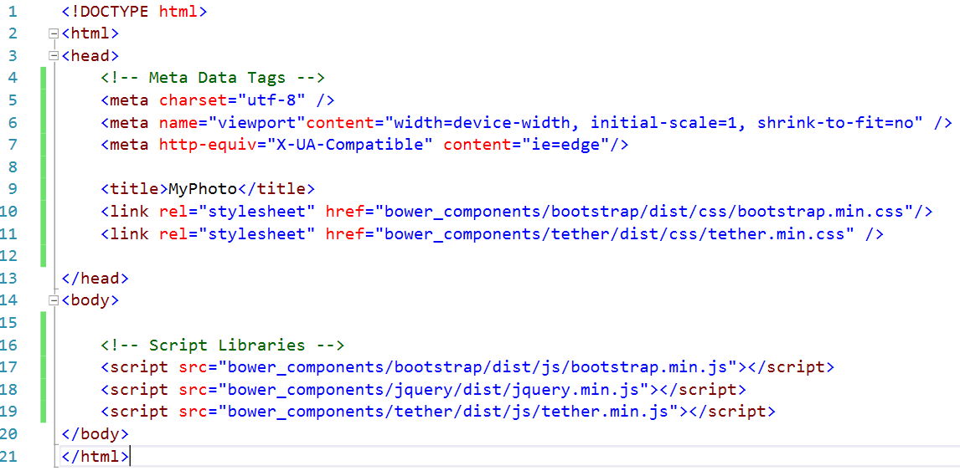
Index.html

Slide 45
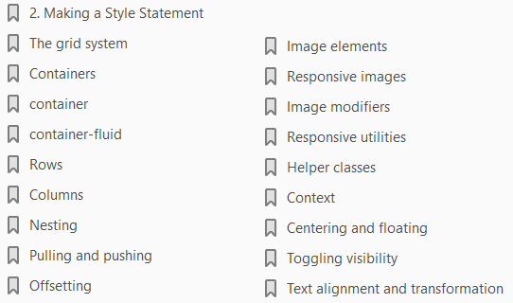
2
Making a Style Statement

Slide 46
Intro
Let us start building the first section of this website.
A first pass at an element of the Services section that presents the list of print sizes available to order.
We will achieve this by building a grid using Bootstrap's grid system, creating image elements within the grid system, applying image modifiers, and leveraging Bootstrap's utility classes to create visual indicators and optimized layouts specific to different display resolutions.
By the end of this chapter, through code examples and studying the Bootstrap source code, you will have gained a deep understanding of the following:
Bootstrap's grid system
Responsive images within Bootstrap
Bootstrap's helper classes
Bootstrap's responsive utilities

Slide 47
The grid system
Bootstrap's grid system is arguably its most impressive and most commonly used feature.
Therefore, mastering it is essential for any Bootstrap developer as the grid system removes many of the pain-points associated with page layouts, especially responsive page layouts.
The grid system solves issues such as the horizontal and vertical positioning of a page's contents and the structure of the page across multiple display widths.
Bootstrap 4 being mobile-first, the grid system is optimized for smaller viewports and scales up to suit larger viewports, as opposed to scaling down to smaller viewports.

Slide 48
What is a viewport?
A viewport is the available display size to render the contents of a page.
For example, the size of your browser window, minus the toolbars, scrollbars, and so on, on your display is your viewport.
Mobile devices may indicate their viewport to be larger than it actually is, in order to allow for the display of websites that have not been optimized for display on mobile devices.
As a consequence, websites that take mobile viewports into consideration, may often not render as intended.
As a remedy, the viewport meta tag was introduced by Apple on iOS, and has since been uniformly adopted by all other major browsers.
The viewport meta tag allows you to define the viewport's display size.
The grid is a structure that consists of three distinct, but fundamentally linked, parts: an all encapsulating container, split into horizontal rows which are themselves split into 12 equal columns.
We will take an in depth look into the three building blocks of Bootstrap's grid system (Figure 2.1):

Slide 49
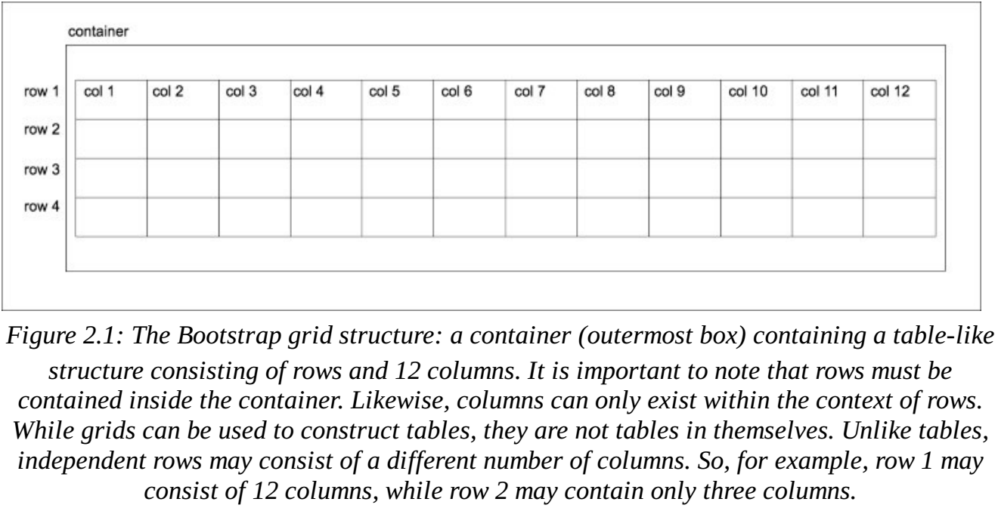
Figure 2.1

Slide 50
Flexbox support
Flexbox is a CSS box model which allows for simple implementation of complex layouts, as opposed to the CSS2 layout modules such as block, inline, table, and positioned.
Flexbox is designed to allow a layout to make the most use out of the available space, through a set of simple rules.
Bootstrap 4 allows the developer to configure the framework to use flexbox for certain components, by changing one variable in _variables.scss-$enable-flex.
Set $enable-flex to true, recompile Bootstrap and a number of Bootstrap components will have their display property set to flex.
This includes the grid system itself, input groups, and the media component.

Slide 51
Containers
Containers are at the core of Bootstrap's grid system, and practically the parent of all Bootstrap pages.
A container is exactly what it sounds like. It encapsulates all other content within a section of a page, providing the base for how the section is rendered.
You can think of a container as representing a canvas in a browser window for your content to be displayed on a canvas that can transform based on its environment.
Unless explicitly specified, your content will never creep outside of this canvas, regardless of the viewport.
A container can apply to the entire contents of a page, where you would have one root container element, or to different sections of a page, where you would have numerous container elements on the page.
There are two types of container classes provided by Bootstrap:
Container
Container-fluid

Slide 52
Container
The container class renders the contents of the page to a fixed width.
This width is typically based upon the width of the viewport, leveraging CSS media queries to determine which width is most suitable.

Slide 53
What are media queries?
Media queries are expressions, which resolve to a Boolean value.
They are used to trigger @media rules that define styles for different media types.
The grid system has five core breakpoints it references, which are defined in _variables.scss.
These are:
extra-small (xs)
small (sm)
medium (md)
large (lg) and
extralarge (xl)

Slide 54
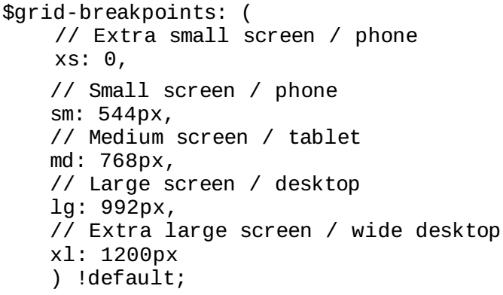
What are Breakpoints?
Breakpoints in relation to web development layouts are predefined vertical and horizontal dimensions at which the style rules change.
As these rules break, they trigger another set of rules optimized for those dimensions.
These rules are triggered by media queries, querying the dimensions of the viewport.
For example, @media (min-width: 768px) will trigger a set of rules when the viewport is more than 768px wide.
Let's take a look at _variables.scss:
Here, Bootstrap is defining the five breakpoints' minimum and maximum width variables, and the associated display types.

Slide 55
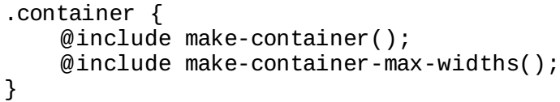
What are Breakpoints? |
Bootstrap will reference these variables throughout all its Sass code as the breakpoints can now be accessed as properties of $grid-breakpoints.
We can also see the variables for the various container sizes, associated with the appropriate breakpoints.
Look at the code in Listing 2-1
For example, container-tablet is set to 750 px: 720px plus the value of grid-gutter-width, which is 30px.
As you can see from the comments in the code, container-** is associated directly with screen-**.
Then, these sizes are leveraged via media queries in _grid.scss to set the desired width of the container.
Let's take a look inside _grid.scss at the .container class:
The make-container() and make-container-max-widths() are mixins with rules to center the container within the viewport and set max-width rules, respectively.

Slide 56
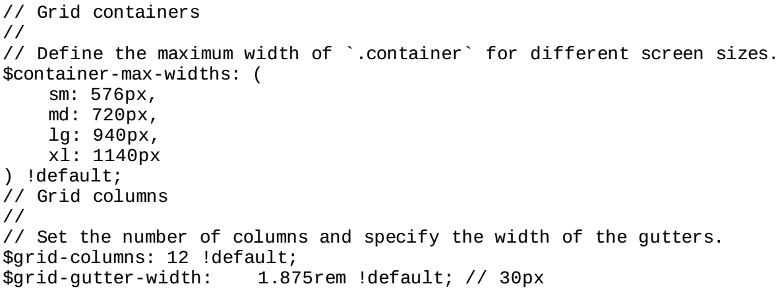
Listing 2-1

Slide 57
What mixin?
A mixin in this context is a set of predefined style rules encapsulated in a variable, which can be used within another rules definition.
This is great for code maintenance and don't repeat yourself (DRY) principles.
You will also find make-container and make-container-max-widths within _grid.scss.
The make-container mixin centralizes the alignment of the container using margin and padding rules.
Have a look at the following code:
INCOMPLETE PG 57

Slide 58
Container-fluid
The other type of container, container-fluid, differs from container in two distinct ways:
It takes up the full-width of the viewport, except for 15 pixels padding left and right
It doesn't concern itself with breakpoints
The container-fluid allows the page to be fully responsive to all widths, providing smoother transitions.
When responding to breakpoints, container snaps the layout to the appropriate width, while container-fluid progressively alters the layout.
The only difference in the markup is that instead of the container class being applied to the container div, the container-fluid class is applied.
Look at the code snippet (Figure 2.3)
The container element now sits 15 pixels from the edge of the browser.
When we use container, the container already has a hard-coded width defined.
This width is based on the viewport. For example, at a resolution of 1200 px wide, the container would be 1140 px wide.

Slide 59
Container-fluid |
At a resolution of 1280 pixels, the container would remain at 1170 px wide, because the container only responds to certain breakpoints.
When we use container-fluid, the container width is dynamic, because container-fluid responds to every horizontal change and bases the width solely on the padding values from the make-container mixin.container, on the other hand, responds only at specific widths. container-fluid is the approach to take when building a page which needs to work across all display sizes and forms, especially when building mobile-first applications.
The container ensures that our contents will always display within a defined area on the page.
But what about positioning content within the container? This is where rows come into play.

Slide 60
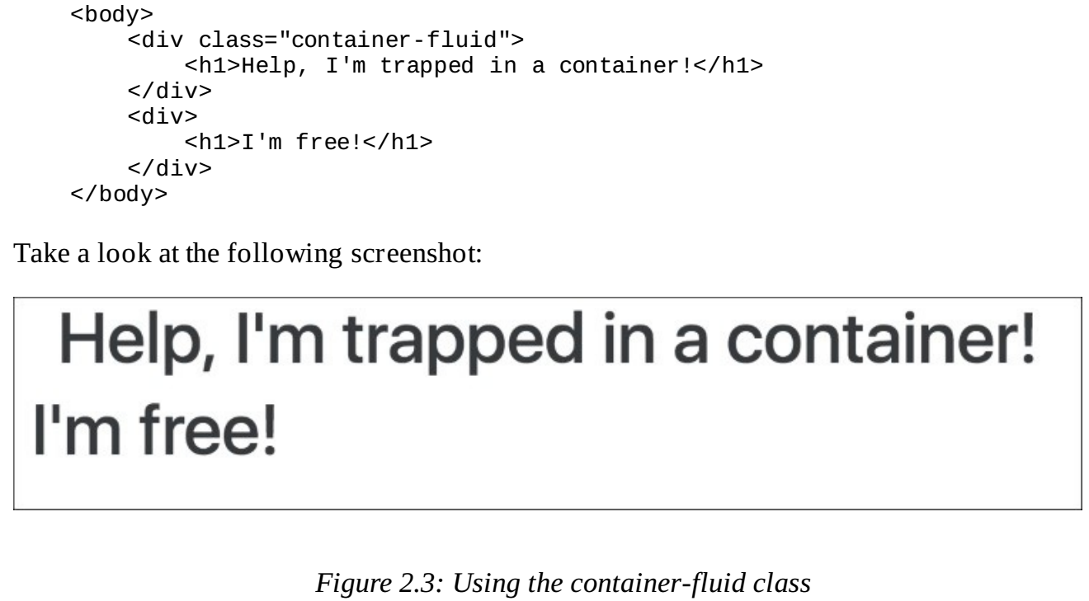
Figure 2.3

Slide 61
Box sizing
In CSS, every element is represented as a rectangle, or box.
Each box has a number of properties associated with it to define how the element is rendered. This is the CSS Box Model.
The box-sizing property of an element defines how the Box Model should calculate the width and height of elements.
The default value for box-sizing in the CSS box model is content-box.
The content-box property only includes the content of an element when calculating the size of that element.
Bootstrap 4 defaults the value of box-sizing to border-box.
The border-box property includes the padding and border, as well as the content of the element in the calculation of the height and width of the element. Note that the margin is not included in the calculation.
The third possible value for box-sizing is padding-box.
The padding-box property, as the name suggests, only uses the content and the padding in calculating the size of an element.

Slide 62
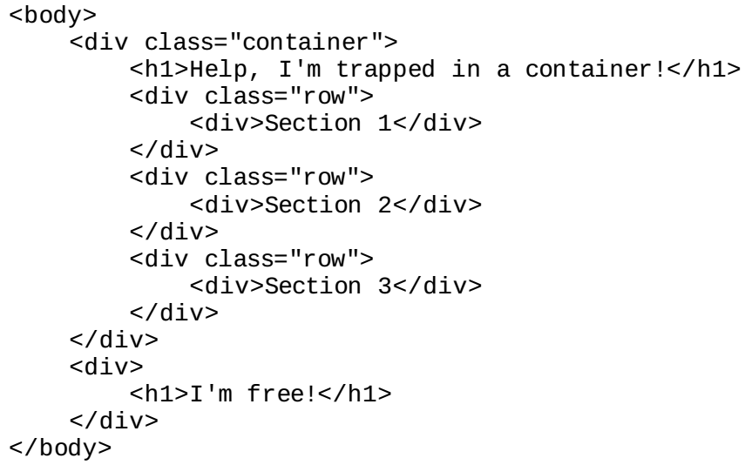
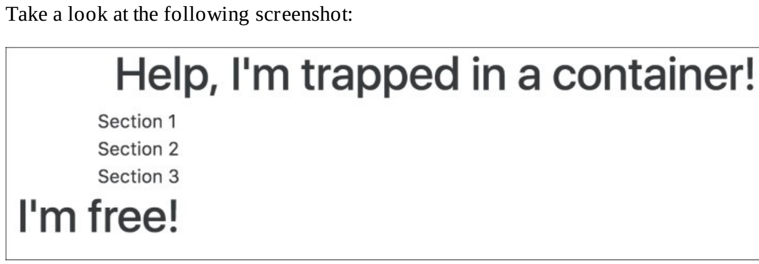
Rows
A row is used to define a selection of elements that should be dealt with as a horizontal group.
As such, rows reside within a container element.
The power of the row lies in being able to stack content vertically.
Almost like containers within a container, or defining a section of the page.
The true power of rows only becomes apparent when they are used with columns.
Creating a row is as simple as applying the row class to the desired element:

Slide 63
Columns
Columns are the most important piece of the grid system.
Rows exist within containers, and those rows are split up into 12 equal columns.
Let's take a look at an example, by taking the first step into creating the print sizes section of MyPhoto.
There will be 12 print sizes offered. Let's list those sizes horizontally (Figure 2.5).
As usual, we have our container.
Within that container, we have a row, and within that row we have twelve individual elements with the col-sm-1.
This produces a very neat list of evenly spaced elements in a single row on the page.

Slide 64
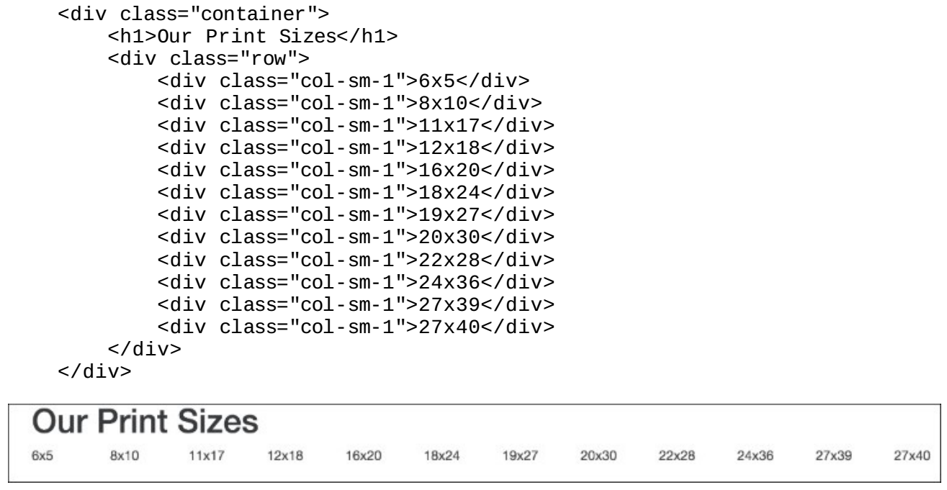
Figure 2.5

Slide 65
Nesting

Slide 66
Pulling and pushing

Slide 67
Offsetting

Slide 68
Image elements

Slide 69
Responsive utilities

Slide 70
Helper classes

Slide 71
Text alignment and transformation

Slide 72
Bootstrap History - Wiki

Slide 73
Bootstrap History - Wiki
Bootstrap, originally named Twitter Blueprint, was developed by Mark Otto and Jacob Thornton at Twitter as a framework to encourage consistency across internal tools.
Before Bootstrap, various libraries were used for interface development, which led to inconsistencies and a high maintenance burden.
It was renamed from Twitter Blueprint to Bootstrap, and released as an open source project on August 19, 2011.
On January 31, 2012, Bootstrap 2 was released, which added a twelve-column responsive grid layout system, inbuilt support for Glyphicons, several new components, as well as changes to many of the existing components.
On August 19, 2013, Bootstrap 3 was released, which redesigned components to use flat design, and a mobile first approach.
On October 29, 2014, Mark Otto announced that Bootstrap 4 was in development.
The first alpha version of Bootstrap 4 was released on August 19, 2015.

Slide 74
Bootstrap History – Wiki |
The first beta version was released on 10 August 2017
The stable version of Bootstrap 4 was released on January 18, 2018 basically improving print styles, border utilities and provides more control over the flexbox.`

